Slide 1

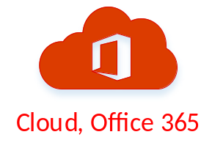





ADFS Server
Domain Controller
Access to service
Access denied
Redirect to Azure AD
Home realm discovery
Redirect to on-premises ADFS environment
Authenticate against AD
Return security token
Redirect to Azure AD
New token returned
Send token to service
Retrieve info when needed
Return cookie and info requested

